Slide 1
Digital Transformation:
Defining Your Journey to Success
Lance Fountaine
Principal Advisor, Business Transformation
OSIsoft, LLC
January 26, 2018

Slide 2
Introduction

Slide 3
Session Agenda
Digital Transformation: An Introduction to the Vision
Understanding the Customer Journey
  Vision Alignment
  Building an Effective Strategy
  Executing for Success
Conclusion: Key Takeaways
Q&A

Slide 4
Digital Transformation:
An Introduction to the Vision

Slide 5

Value in Data: Statements from Leading Resources
US Smart Manufacturing Leadership Coalition (2011)
  20% Increase in Operating Efficiency
  25% Improvement in Energy Efficiency
  40% Reduction in Cycle Times
  Tracking and Traceability through the Supply Chain
PwC on Industry 4.0 (2014)
  18% Increase in Efficiency within 5 Yrs
  Paves Way for Disruptive Digital Business Models
  Digitization is the Key to Sustainable Corporate Success
McKinsey on IoT (2015)
  Potential Economic Impact in Factories: $1.2 to $3.7 Trillion USD by 2025

Slide 6






Business Impacts: An Agent for Change
Asset
Health
Safety
Process
Regulation
Energy
Quality
1000+ less paper documents
5 less plant shutdowns
$12M/yr/mine
O₂ savings
$46M saved &
37% less errors
$5-40M per event
Saved 640M liters water
Notes:
Here’s just a few examples from across different industries for how our customers have leveraged a digital infrastructure to transform their operations environment and make a business impact. These metrics are many fold the investment cost of a digital infrastructure and often only represent one of many business values.
Discussion topic
Is there a particular area or case study you would be interested in learning more?

Slide 7
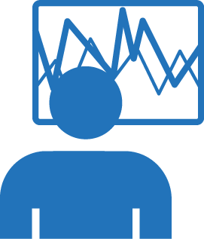


How is Data Used to Achieve Results?
Energy
Utilization
Process
Efficiency
Asset Health
Quality
Safety & Security
Regulatory
Performance
Operators
Craftsmen
Supervisors
Process Engineers
Production Superintendents
CoE experts
Location Managers
Regional/Global Ops
Business leadership
Achieve daily targets
Resolve immediate issues
Maintain schedule/plan
Safe operations
Detect excursions
Maintain process stability
Improve productivity
Improve quality
Understand/grade perf.
Adjust expectations
Establish plans
Calculate forecasts

Slide 8
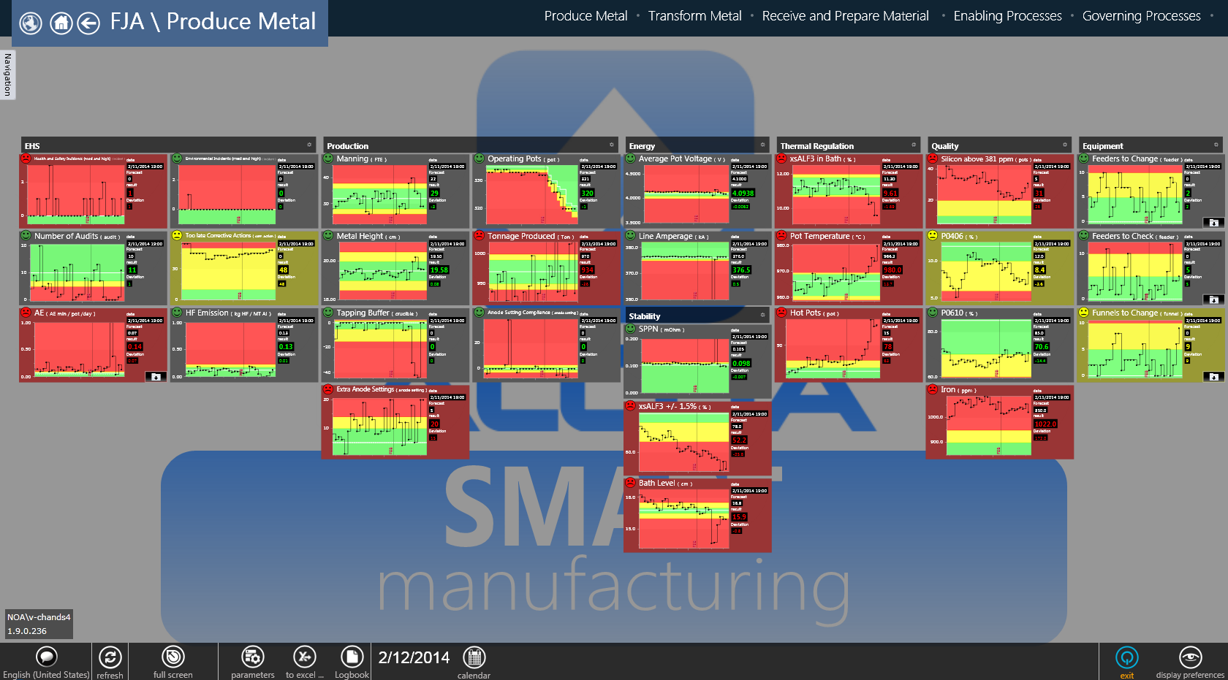
Example of Intelligent Action (Operations KPI Focus)

Slide 9
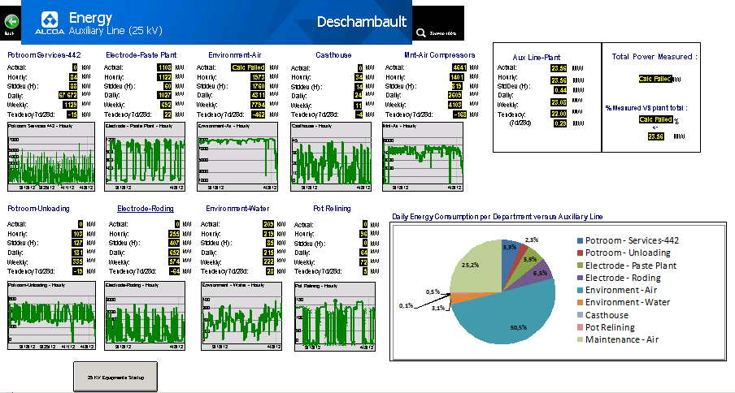
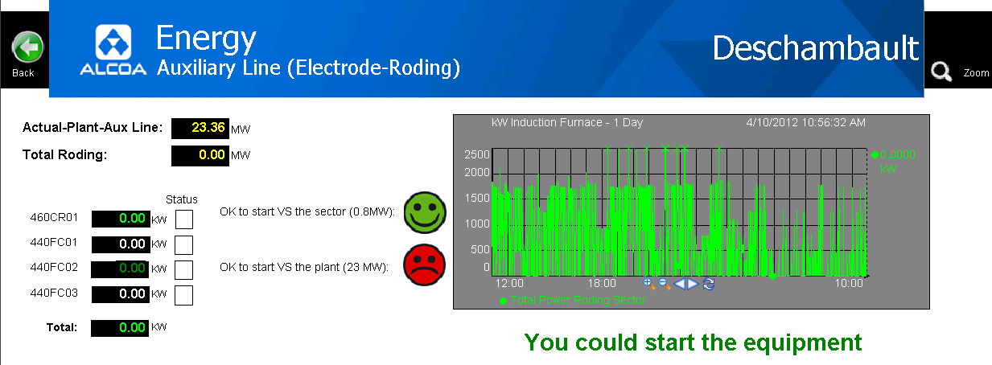
Example of Intelligent Action (Operations Drill Down)

Slide 10
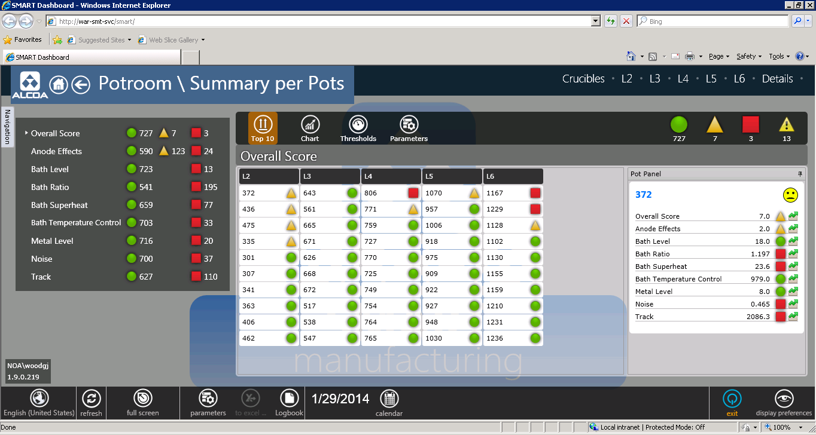
Example of Intelligent Analysis

Slide 11
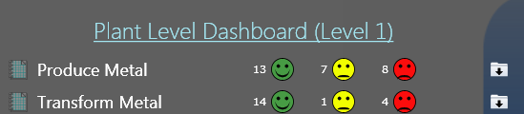
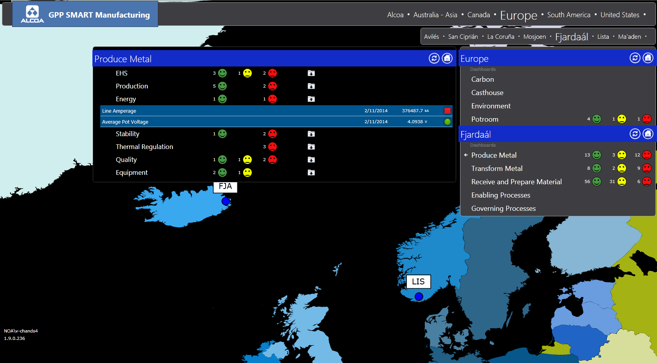
Example of Intelligent Reporting (Management)

Slide 12

Understanding the Enablers for Success
People / Process
  Subject Matter Experts (SMEs)
  Centers of Excellence (CoEs)
  Innovators (Enabled Workforce)
  Change Agents
VALUE
Tools / Applications
  Visualization Tools
  Application Systems
  Analytical Tools (Big Data)
  Reporting Tools
Data Infrastructure
  Data Collection / Historization
  Data Standardization / Enterprise Normalization
  Calculations / Rollup / Aggregation
Network Connectivity
  Ethernet TCPIP / Proprietary
  Wired / Wifi / Cellular
Sensors / Data Sources
  IoT / IIoT Sensors
  Transactional Databases
  Calibration
Data

Slide 13
Recognizing the Aegex Technology
aegex10™ Intrinsically Safe Tablet:
  Windows tablet certified for UL Class I, II, III Division 1 / IECEX Zone 1 / ATEX Zone 1 hazardous areas
  WiFi/4G LTE
  IP65 rugged
  real-time data analysis
  mobility tool for PI System - analyze data at source of collection in hazardous areas
Aegex IoT Sensors:
  intrinsically safe for hazardous areas
  monitor hundreds of ambient conditions
  used in conjunction with tablet to collect and analyze data onsite
OSIsoft+Aegex Use Case scenario
  http://aegex.com/images/uploads/use_cases/Use_Case_OSIsoft_5_Data-Infrastructure-OSIsoft.pdf

Slide 14
Digital Transformation:
Understanding the
Customer Journey

Slide 15

OSIsoft Advisory Services: Enabling Your Journey
Vision
Strategy
Execution
Digital Transformation:
Industry 4.0
Operational Intelligence
Business Impact Results
Smart Manufacturing
IoT / IIoT
Customer Success
Big Data
The Customer Journey
Advanced Analytics
OSIsoft Business Transformation Services
Business Discovery
Strategic Program Development
Business Justification

Slide 16








The Many Names and Faces of Digital Transformation
Vision
Digital Transformation
Strategic Business / Operations Initiatives
Data Driven Operational Excellence / Lean Manufacturing
Leverage of Standard / Best Practice Operating Processes
Advanced Analytics / Machine Learning
Shop Floor Innovation / Self-Service
Enterprise Intelligence / Visibility
Connected Partners / Suppliers
Cyber Security
Cloud
Digital Technology Foundation
Mobile Devices
Standardized Visualization / Analytics / Reporting Tools
Standardized Data
Common Enterprise / Division / Site Infrastructure
Sensors / Edge Devices

Slide 17

The Risks of ‘Executing’ without a Strategy

Slide 18





Traditional Project Based Outcome with Data and Information
Historian
Excel
PLC 1
SCADA 1
PLC 2
SCADA 2
DCS 1
ERP
Asset Reliability
DCS 2
CAPA
Planning and Scheduling
Instrument
Manual 1
Instrument
CBM
Manual 2
EMS
LIMS
Controller
Notes:
Everyone has dealt with this…
We want you to get that you’re going through this
And this is what it looks like
Start with our common ground
The shared condition that usually happens when you link up data technologies
Exisitng customer: they need to get what it can do.
(AF, AF assets, the value of that). KPIs in
Track event sin the pi system.
Moving automated reports
Excel reporting. Spend a day. Eliminate that, now increase their
Productivity by 20%
Let's start with just the big picture of the PI System: what is this whole thing called the PI System, and what does it actually provide? Now, let's start with where a lot of our customers find themselves before they use the PI System.
If I stripped it all down, it really starts with this: you have people that have some tasks that need to get done (here on the right), and you have sources of data that those people want to have access to, and need to have access to (here on the left). There might be, for example, SCADA systems and instruments and plant control system, and all of that is data that these people need. Usually what our customers have before the PI System looks a bit like this.
[first animation]
There's a whole variety of places that they store data: there's an Asset Reliability system, there is a condition based maintenance system, there's a learning management system, and there is a historian for some of the data - and all the systems play different important roles.
[Second animation]
And often our customers start linking these up! The SCADA system feeding to the historian, and other systems feeding their data the historian, and then the Asset Reliability system gets some of its data from the historian BUT it also needs some really specific data from the SCADA system that got washed out in the historizing process… so it needs to be connected directly to the SCADA system. Meanwhile the Condition Based Maintenance [CBM] system is getting data from the historian but also needs specialized asset information from one of the data sources.
[Third animation]
Then that data needs to be forwarded to Excel, and the Planning and Scheduling System and then on to all the people they need to use it. Maybe you hire a whole integration team to tie them together, or maybe you just spent hours each week formatting the data and copy and pasting it in just to send of a spreadsheet that goes stale the moment you email it.
And this is the traditional strategy. One of our customers in Europe actually referred to this as the ‘spaghetti’ strategy they found themselves in.
Additional Notes:
I encourage you to replace the acronyms on this slide with what you know this customer has.
Some of the default: acronyms
DCS – Distributed Control System
CBM – Condition Based Maintenance
LIMS – Laboratory Information System
ERP – Enterprise Resource Planning
PLC- Programmable logic controller
SCADA- Supervisory control and data acquisition
You can bring out the challenges of data collection (variety of formats, geographically spread, speed, breath). The challenges of managing the data (spinning up new databases & silos, storing only averages, slow response times, months to build a new project), and visualizing the data & making the data valuable (copy & paste, email, wait times to retrieve data, needing to code, wait for custom code, then manage it ongoingly)
---------------------------------

Slide 19
Recognizing Key Contributors in Building an Effective ‘Strategy’

Slide 20
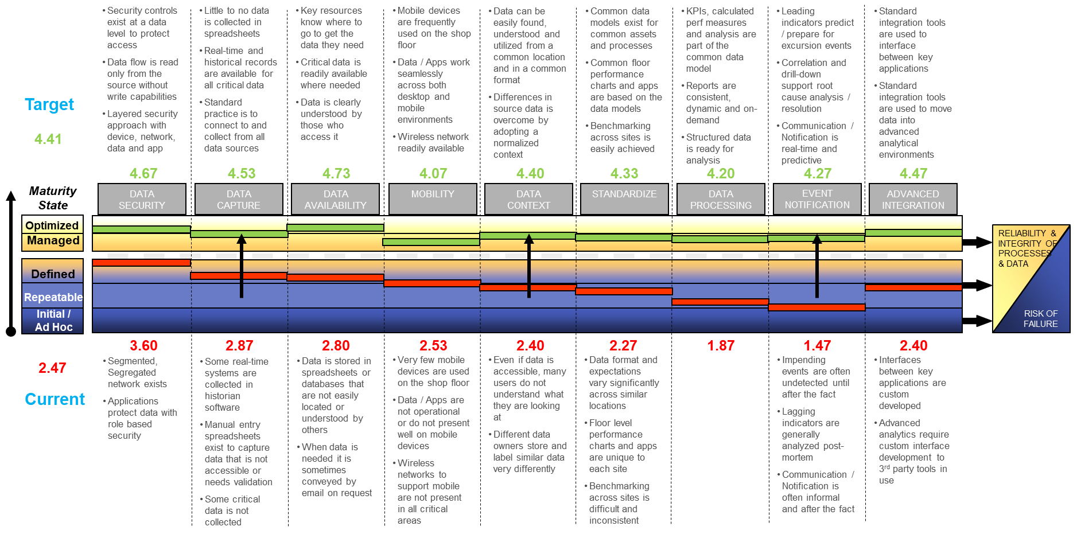
Achieving Success: Recognize Capability and Maturity
Notes:
Every organization uses data as a cornerstone within their operations. Capability and Maturity is really an evaluation of how effective they are in this process. Typically organizations will have areas of both strength and weakness. Capability and Maturity is about highlighting the gaps and targeting areas of focused improvement. Every organization has a journey, and Capability and Maturity helps identify the priority focus areas for needed results.

Slide 21
Achieving Success: It is about Change
Digital Transformation Concepts
  Hidden information, problems
  Data in many locations & not easily accessible
  Multiple versions of the truth
  Common platform & tools
  Real-time data transparent, available to all
  Standardized Data Model
  Proactive problems solving to reduce Excursions
  Process modeling & improvements
  Customer connections
Traditional Operating Processes
Operational Excellence in the 21st Century
Notes:
It is also critical to recognize the role of people and process in enabling IoT success. It is about more than just the technology. People and Process need to change to support a new model of operation. Remember Einstein’s definition of insanity, ‘you can not keep doing the same things over and over, and somehow expect different results’.

Slide 22
Achieving Success: Project to Program Thinking
VALUE
Performance Management
Environmental Reporting
Equipment Health Mgmt.
Incremental Value
Operations Management
Application Benefits
Value Realization
TIME
Initial Investment
VALUE NOW
VALUE OVER TIME
Notes:
Another very important concept to recognize as part of the customer journey to IoT success is the evolution from project to program thinking. IoT is not simply about driving a success with one project, but instead about enabling ongoing continuous improvement with data as an asset. IoT needs to recognize data as an infrastructure, and leverage it for ongoing success in every aspect of operations and business.

Slide 23
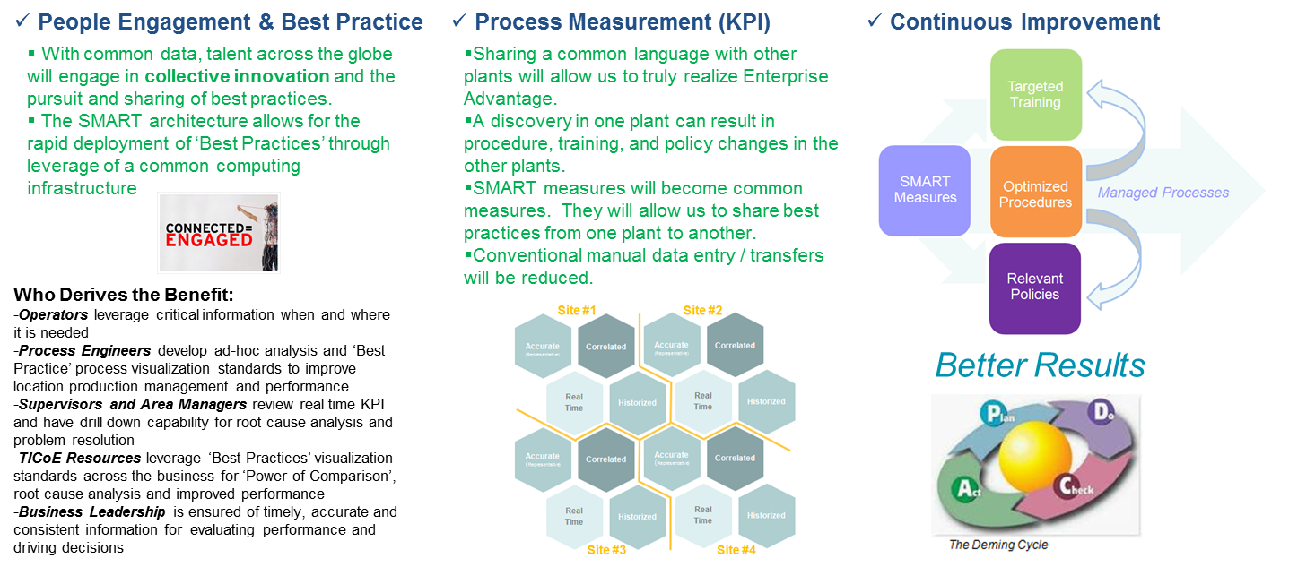
Achieving Success: Program Principles
Notes:
The IoT platform should serve as a foundation for people, process and technology to deliver results. Results should also be reflected company wide, including site operations, division / business unit management, and corporate level management.

Slide 24
Achieving Success: The Enterprise Architecture
(Infrastructure, Applications, Configurations, Data)
Notes:
This slide includes an example of an enterprise architecture that was adopted by Merck.

Slide 25
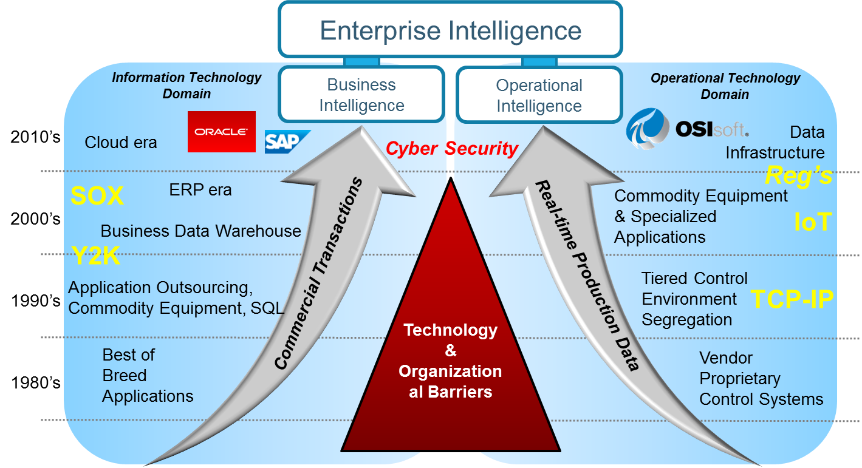
Achieving Success: Recognizing the Criticality of IT/OT Convergence

Slide 26
Conclusion:
Key Takeaways

Slide 27
Key Takeaways
‘Digital Transformation’ Offers Tremendous Value Opportunity and Competitive Differentiation
The ‘Customer Journey’ Requires a Comprehensive Strategy that is Aligned with Existing Company Objectives, Strategic Initiatives and Operating Practices
Ongoing Success is Driven Incrementally through Continuous Improvement that Effectively Leverages People, Process and Technology

Slide 28
Q&A

Slide 29
Lance Fountaine
Principal Advisor, Business Transformation
OSIsoft, LLC
lfountaine@osisoft.com

